Slide 1

Putting structured data into individual entry pages in biological databases and tools
BioHackathon 2018 - Paris
http://bh2018paris.info/
Proponent: Jun-ichi Onami, Tatsuya Kushida, Shigeru Yatsuzuka
National Bioscience Database Center (NBDC)
JAPAN SCIENCE AND TECHNOLOGY AGENCY (JST)
Project links
https://github.com/elixir-europe/BioHackathon/tree/master/interoperability/Putting%20structured%20data%20into%20individual%20entry%20pages%20in%20biological%20databasehttp://github.io/your_repo
Notes:
Hi everyone,
Our Hackathon Theme is,
"Putting structured data into individual entry pages in biological databases and tools"

Slide 2
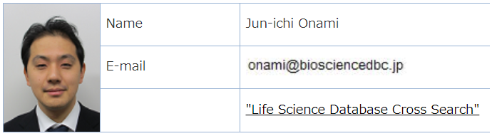
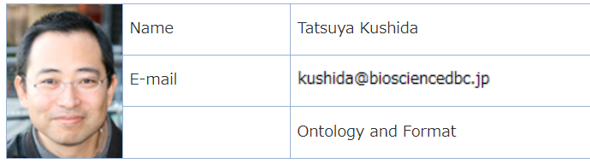
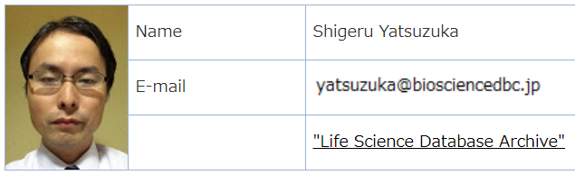
from tomorrow
Notes:
In this project, 3 persons are participated in.
But Team leader, Onami will come tomorrow.
So today, we: Kushida and Yatsuzuka introduce our project.

Slide 3
Background information
Notes:
Background information

Slide 4
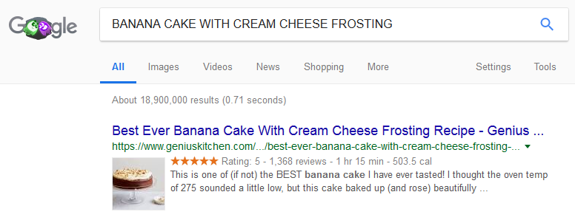
When you want to search the recipe of BANANA CAKE…
thumbnail image
reviews number
nutrition calories
Rating info
Cook time
These snippet information are useful to find good recipe data.
Notes:
By the way, when you want to search the recipe of BANANA CAKE,
You would search these word by search engine.
The search result shows like this.
(対象を指しながら)The snippet contains thumbnail image, Rating information, reviews number, cook time, and nutrition calories.
I think, these snippet information are useful to find good recipe data.

Slide 5
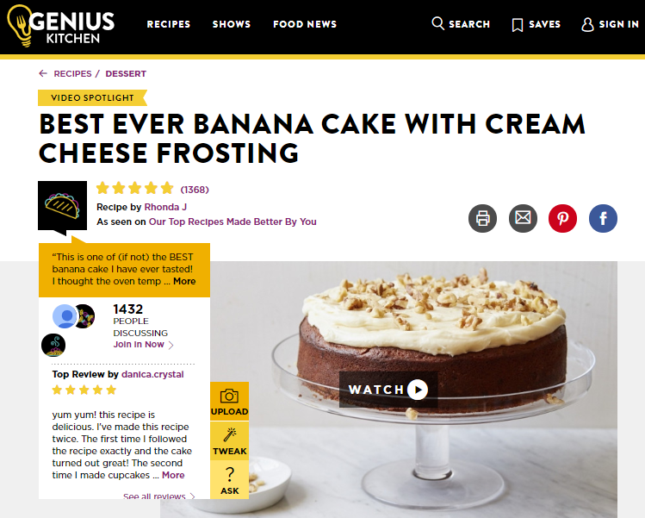
Inserted structured data into html source (=markup)
***HTML SOURCE***
<script type="application/ld+json">
{"@context":"http://schema.org",
...........................
"totalTime":"PT1H15M",
"aggregateRating":{"@type":"AggregateRating",
"ratingValue":"5.0","reviewCount":"1368"},
"nutrition":{"@type":"NutritionInformation",
"calories":"503.5",......................................},
"thumbnailUrl":"https://images.video.snidigital.com/ image/upload/w_1024,h_576,c_fit/prod/genius/sni1 uss-aakamaihdnetScripps_- _Genius_Kitchen129781170925_4179510_Best_E ver_Banana_Cake_1517343623jpg.jpg",
...........................
}
</script>
https://www.geniuskitchen.com/recipe/best-ever-banana-cake-with-cream-cheese-frosting-67256
Is it a Piece of Cake?
How to use markup schema?
Notes:
This kind of rich snippet need structured data in html source.
It's also called "markup".
Banana cake recipe contained the structured data.
But how to make it?
Is it a piece of cake to construct such kind of data?

Slide 6
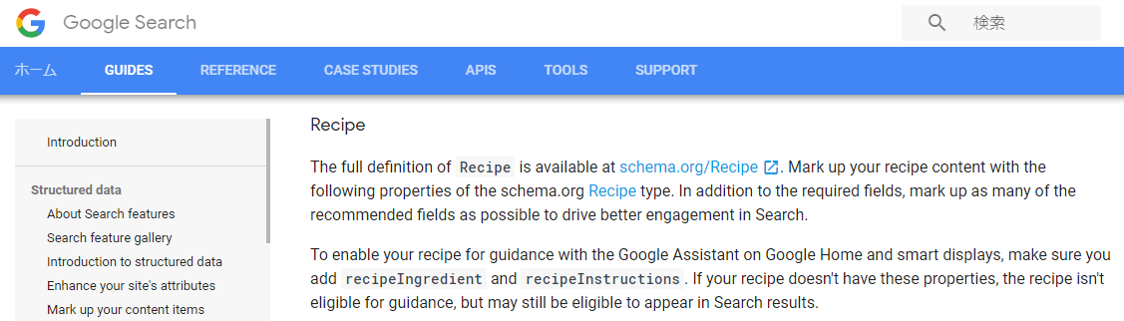
There is a guideline for the Recipe data markup.
https://developers.google.com/search/docs/data-types/recipe#guidelines
Based on schema.org/Recipe
Actually, not all of Recipe schemas are used
Notes:
There is a guideline for the Recipe data markup.
In the google search guideline, it is based on schema.org/Recipe.
But actually, not all of recipe schemas are used.

Slide 7

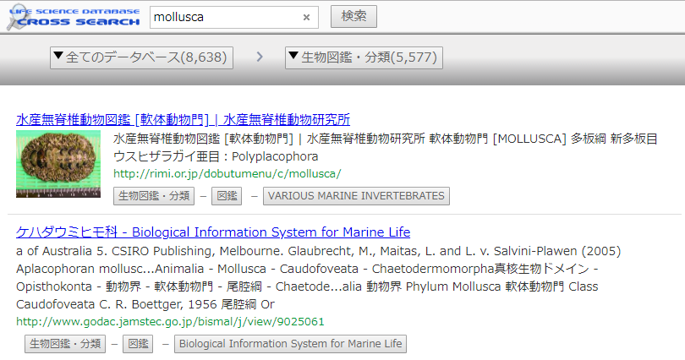
Web page with markup schema
provide
structured data
provide
semantic data
advanced data user
(informatician)
schema based
search engine
* easy integration
* accurate analysis
for all users,
provide rich data
efficient and accurate discover
Notes:
Web page with markup schema can
provide structured data to schema based search engine.
is also provide rich data and efficient and accurate discover for all users
And web page with markup schema also provide semantic data to advanced data user or informatician for easy integration or accurate analysis

Slide 8
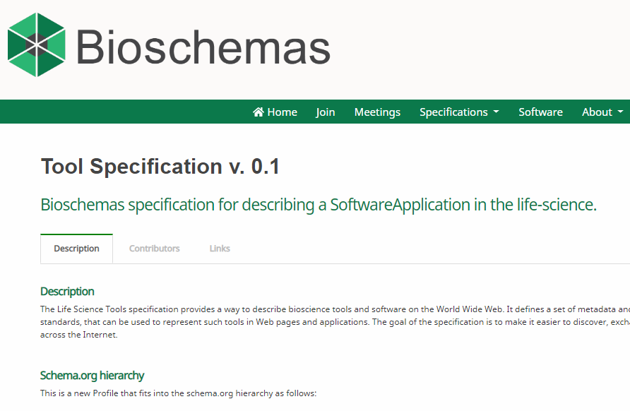
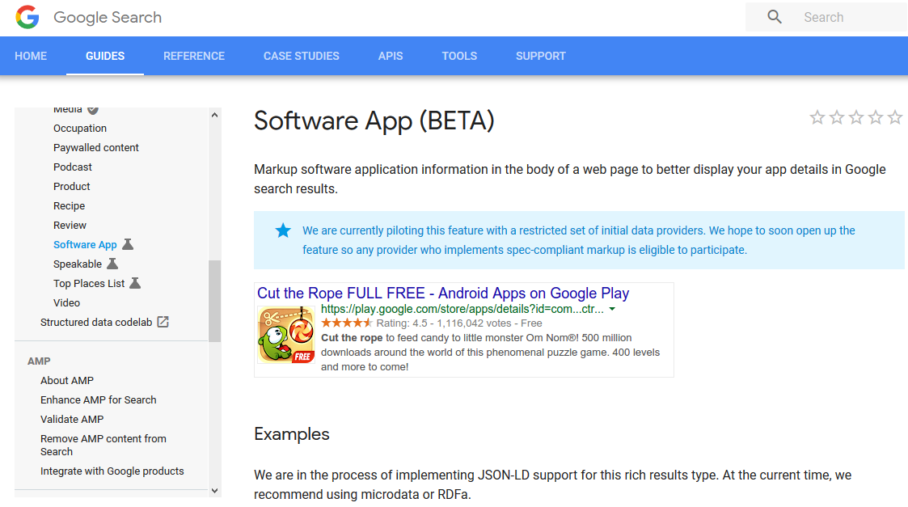
How about in biological field?
https://developers.google.com/search/docs/data-types/recipe#guidelines
http://bioschemas.org/specifications/Tool/
Some markup schema standards for application tools are establishing
Notes:
So, recipe is good.
How about in biological field?
We think Some markup schema standards for application tools are establishing.

Slide 9
Goal
We will try to markup the web page of biological databases and tools.
Discussion about the markup methods and schema for biological tools.
Notes:
So,
We will try to markup the web page of biological databases and tools.
and
We would like to discuss about the markup methods and schema for biological tools.

Slide 10
Hacking schedule
13th. Nov. Discussion about schema for biological
databases and tools
14th. Nov. Discussion and scripting
15th. Nov. Scripting and markup program execution
16th. Nov. Review
Notes:
Our hacking schedule is like this.
November 13rd. discussion about schema for biological databases and tools
November 14th. discussion and scripting
November 15th. scripting and markup program execution
November 16th. Review

Slide 11
Post-biohackathon perspectives
Putting constructed data into some public databases
Optimizing our Life Science Cross Search to discussed schema
➔ Find the best practice to put good schema markup into biological database web page
Notes:
Post-biohackathon perspectives is…
Putting constructed data into some public databases
Optimizing our Life Science Cross Search to discussed schema
And we would like to find the best practice to put good schema markup into biological database web page

Slide 12
Contact and links
Contact (s)
Jun-ichi Onami (onami@biosciencedbc.jp)
Tatsuya Kushida (kushida@biosciencedbc.jp)
Shigeru Yatsuzuka (yatsuzuka@biosciencedbc.jp)
Links related to the project
Life Science Cross search
https://biosciencedbc.jp/dbsearch/index.php?lang=en
Notes:
This is the Contact and links information.
That's all.
Any question?

Slide 13
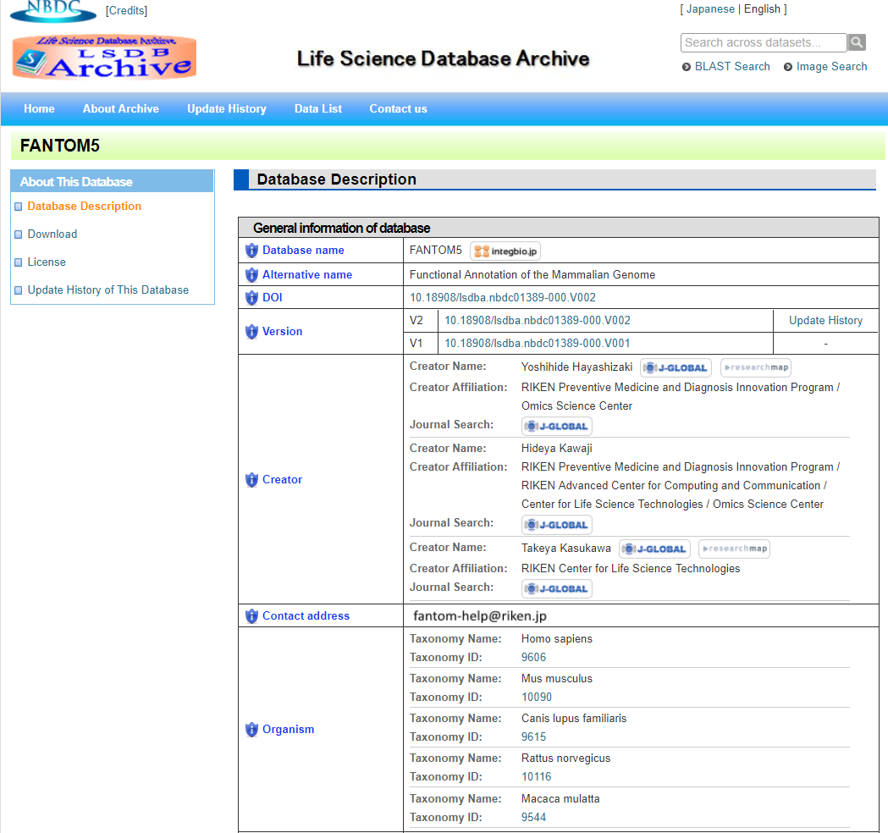
+α Database (archive) page example: FANTOM5

Slide 14
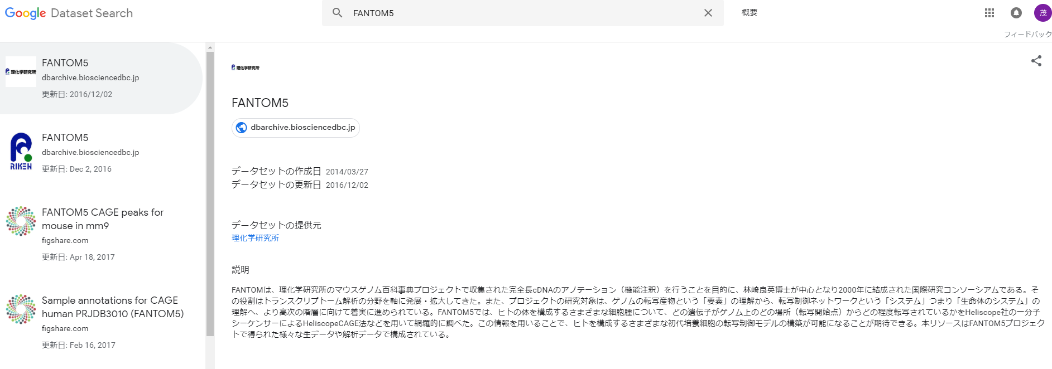
+α Google Dataset Search result

Slide 15
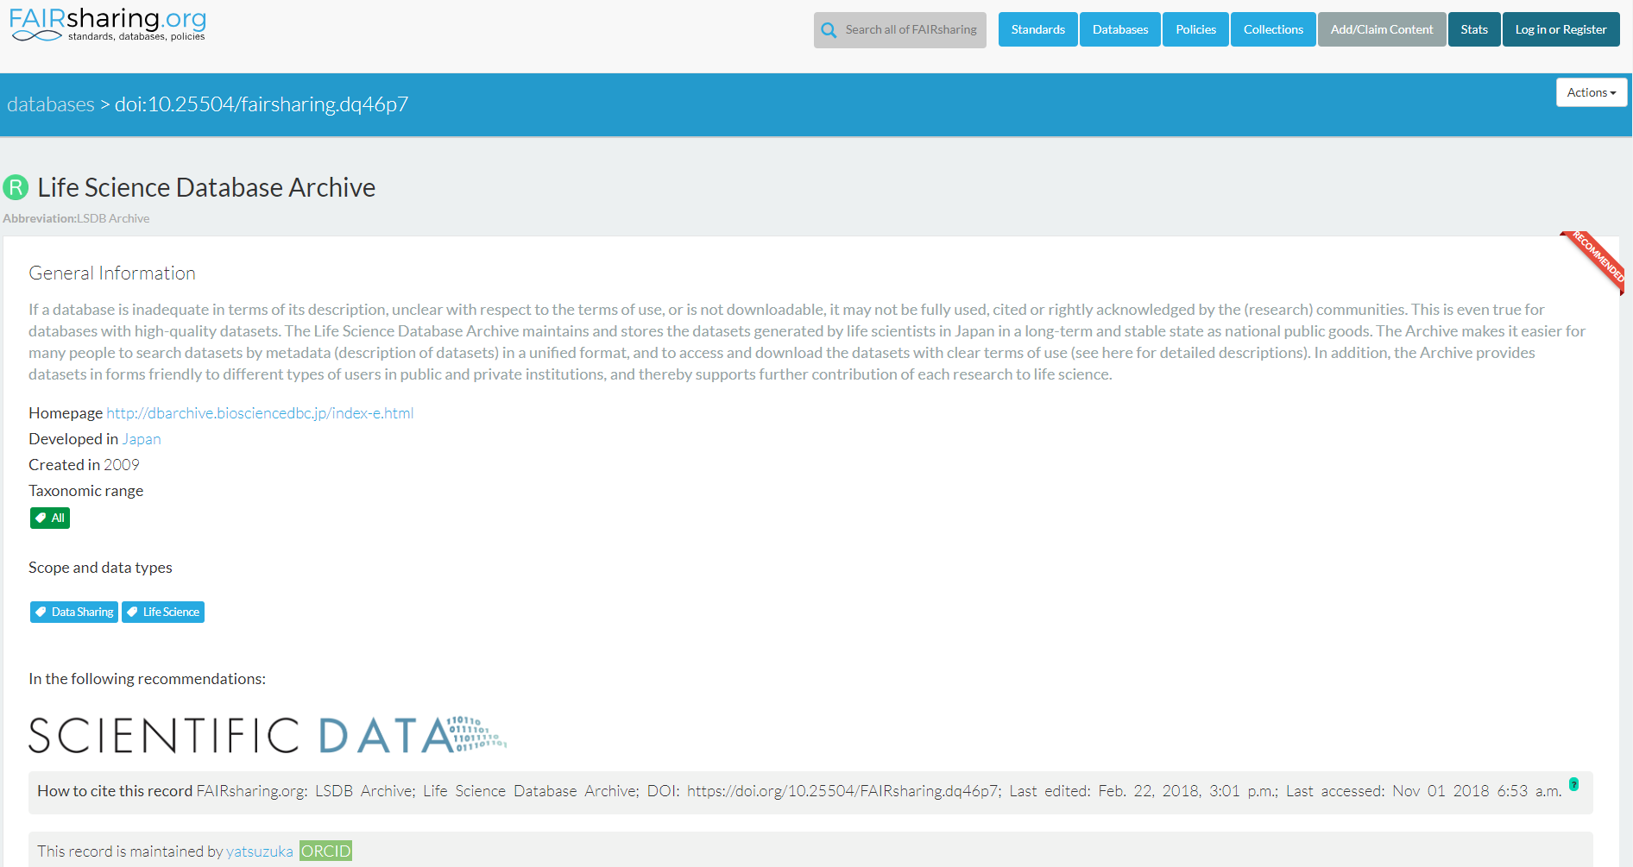
+α Example of FAIRsharing
{
"@context": "http://schema.org",
"@id": "https://doi.org/10.25504/FAIRsharing.dq46p7",
"@type": "Dataset",
"alternateName": "LSDB Archive",
"citation": {
"@type": "CreativeWork",
"identifier": "doi:10.25504/FAIRsharing.dq46p7"
},
"datePublished": "2016-08-17 03:47:58",
"description": "If a database is …",
"identifier": "10.25504/FAIRsharing.dq46p7",
"license": "https://creativecommons.org/licenses/by-sa/4.0/. ...",
"name": "Life Science Database Archive",
"url": "https://doi.org/10.25504/FAIRsharing.dq46p7"
}

Slide 16
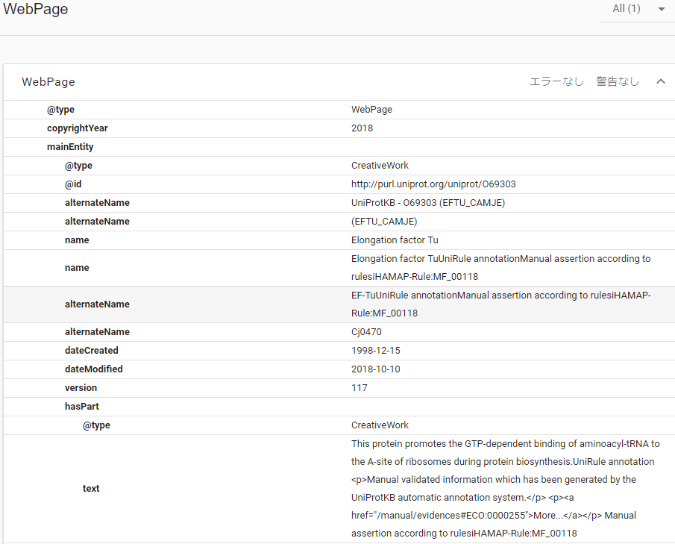
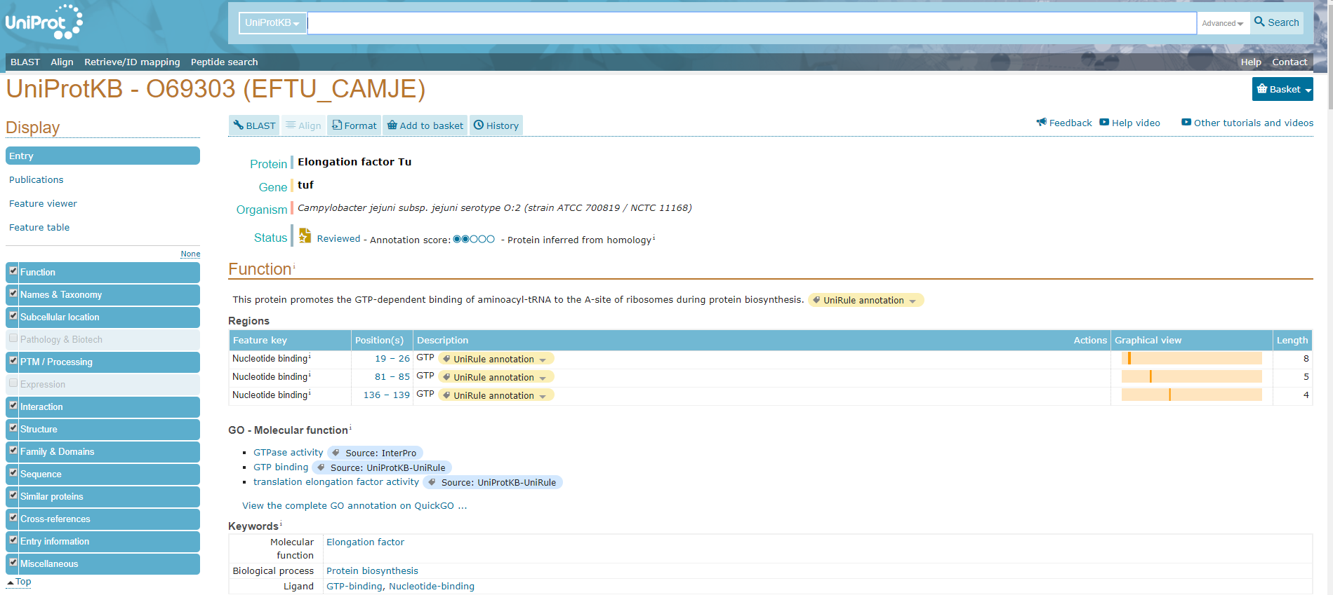
+α Example of UniProt

